Slide 1
Southeast Airlines : Business Strategy Analysis
Aatish Suman
Adheesh Ajit Phadnis
Aneesh Phatak
Chaoying Lyu
Nishitha Maniganahalli Venkatesh

Slide 2
What is the Business Problem?
Increase the net promoter score : Promoters - Detractors
Promoters - Ratings > 8
Passive - Ratings 7-8
Detractors - Ratings < 7

Slide 3
Approach to the Business Problem
Base Analysis
Identifying significant Parameters
Slicing data and creating multiple data sets for further analysis
Advanced models
Results

Slide 4
Data Subsets
Texas state data
Top 3 airlines partners based on Number of instances
Cheapseats Airlines Inc.
Sigma Airlines Inc.
Northwest Business Airlines Inc.
Category of customers as Personal Travel
Airline Status as Blue

Slide 5
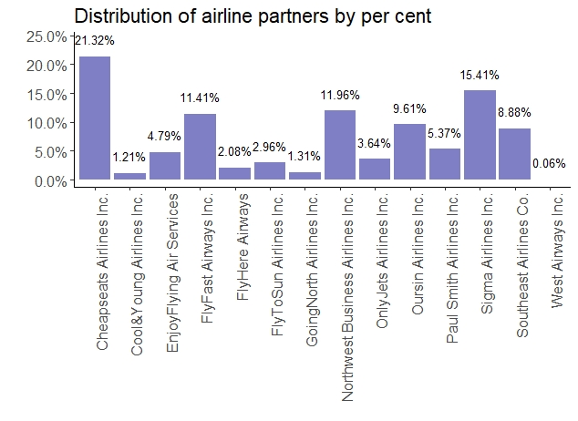
Base Analysis
Percentage frequency of Airline Partners

Slide 6
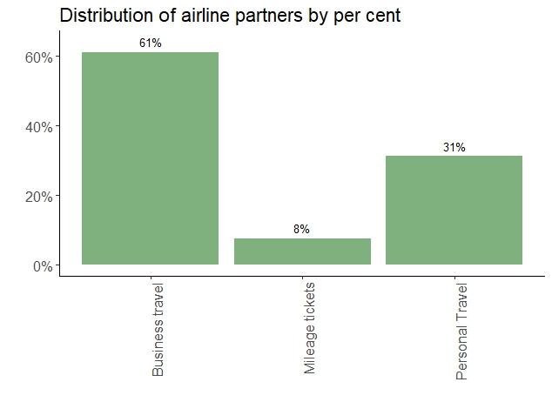
Percentage frequency of Type of Travel

Slide 7
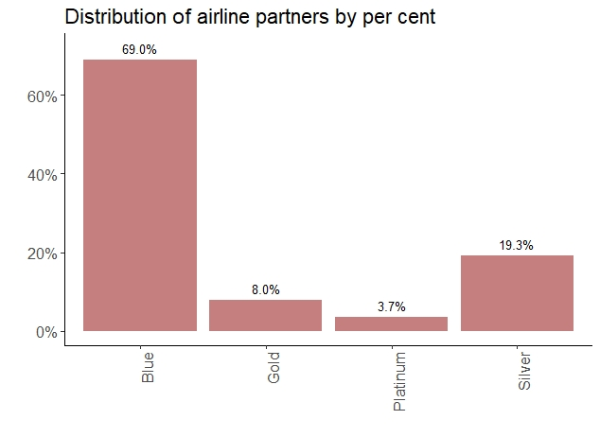
Percentage Frequency of Airline Status

Slide 8
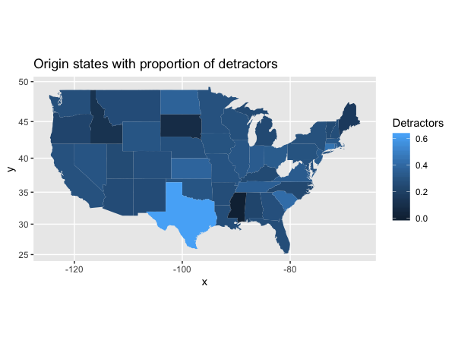
Proportion of detractors in each origin state

Slide 9
Analysing travelers from Texas
Total travelers: 901
Detractors: 564
Focus: Airline status, Gender, Price sensitivity, Type of travel, Class
Insights from association rule analysis
Major detractors
Airline status: Blue
Type of travel: Personal

Slide 10
Advanced Models : 1
Summary
Subset of top 3 airlines
Data Cleaning
Likelihood to recommend binned as
<8 - Detractors
>=8 Promoters
Association rule mining for detractors and promoters
SVM on cheapseats airline subset

Slide 11
Typical Detractors
Customers with following characteristics happen to be detractors
Old age (>60)
Type of travel : Personal Travel
Frequent Flyer accounts : 0
Gender : Female
Departure delay : within 20 minutes
Class : Eco
Airline Partner : Cheapseats airlines

Slide 12
Typical Promoters
Customers with following characteristics happen to be promoters
Type of Travel : Business Travel
Flight Cancelled : No
Gender : Male
Flights per year : 0-30
Middle Aged : 30 - 60
Price sensitivity : 1
Airline Status : Silver

Slide 13
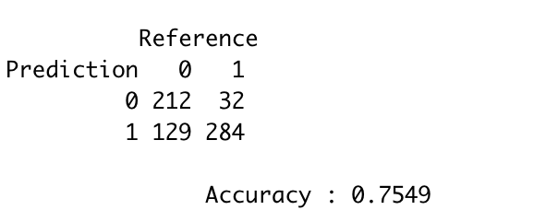
Prediction model for Cheapseats Airlines Inc.

Slide 14
Advanced Model 2 : Exploratory Analysis
83.96% of the passengers with travel type as Personal are detractors

Slide 15
Advanced Model 2 : Exploratory Analysis – All data
Association analysis indicates type of travel and airline status to be strongly related
Passengers with mileage tickets on airlines with status as “Silver” are found to be promoters
Passengers with type of travel as personal on airlines with status as “Blue” are found to be detractors
Passengers having origin state as Texas tend to be detractors

Slide 16
Advanced Model 2 : Main Analysis – All rows
Only the columns which have a high association with each other were considered
Airline.Status, Type.of.Travel, Eating.and.Drinking.at.Airport, Departure.Delay.in.Minutes, Flights.Per.Year, Price.Sensitivity, olong, dlat, Total.Freq.Flyer.Accts
The numerical columns were binned to better classify the data
Model train accuracy ~ 79.5%
Model test accuracy ~ 80.5%
Model F1 score ~ 0.87 (a measure of test accuracy)
Strongest predictor – Type.of.Travel_Personal Travel (dummy variable created for Type.of.Travel having “Personal Travel”)
Prediction of personal travel passengers as detractors ~ 86.4%
Conclusion – Passengers with travel type as personal are and predicted to be detractors and the airline should focus more on them

Slide 17
Advanced Model 2 : Exploratory Analysis – Personal Travel
Data with type of travel as “Personal Travel” was considered for association mapping – 3212 rows
There seems to a weak association of gender and airline status
Male passengers on airlines with status as “Silver” tend to be promoters
Passengers on airlines with status as “Blue” tend to be detractors
Results are similar to those found earlier

Slide 18
Advanced Model 2 : Exploratory Analysis – Personal Travel, Blue Airline
Data with type of travel as “Personal Travel” and airline status as “Blue” was considered for association mapping – 2504 rows
89.85% passengers are detractors
There seems to a strong association of age and gender for promoters, and total frequent flyer accounts and gender for detractors
Male passengers between the age of 30-45 tend to be promoters
Female passengers with no frequent flyer accounts tend to be detractors

Slide 19
Advanced Model 2 : Main Analysis – Personal Travel, Blue Airline
Only the columns which have a high association with each other were considered
Age, Gender, Flight.Distance, Eating.and.Drinking.at.Airport, olong, Arrival.Delay.in.Minutes, Loyalty, Total.Freq.Flyer.Accts
The numerical columns were binned to better classify the data
Model train accuracy ~ 89.85% (not a good metric)
Model test accuracy ~ 89.76% (not a good metric)
Model F1 score – 0.95 (a measure of test accuracy)
Strongest predictor – Gender_Male (dummy variable created for Gender “Male”)
Prediction of female passengers as detractors ~ 99.25%
Conclusion – Female passengers with travel type as personal and on airlines with status as Blue are and predicted to be detractors and the airline should focus more on them

Slide 20
Advanced Model 2 : Overall Analysis Conclusions
The airline should focus on passengers with type of travel as personal
Percentage – 31.24% (significant)
Average rating – 5.28 (vs overall average 7.17)
Furthermore, they should focus more on the airlines with status as “Blue” in this category
Percentage – 24.35% (significant)
Average rating – 4.86 (vs overall average 7.17)
Furthermore, they should focus more on the female passengers in this category
Percentage – 15.7%
Average rating – 4.78 (vs overall average 7.17, overall female average 6.98)
No definite conclusions could be made about which factors most strongly affect the ratings

Slide 21
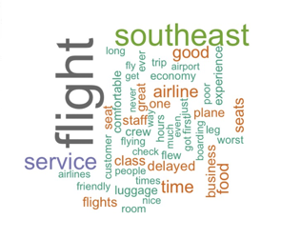
Text analyst
Summary about free text
265 Comments
7500 words
2091 positive words
2091 negative words

Slide 22
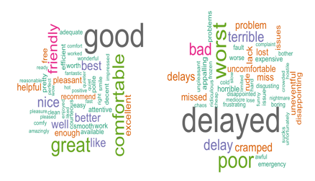
Text analyst
Positive words
Friendly
Reasonable
Comfortable
Negative words
Delayed, delay, delays
Cramped
Frozen , cold

Slide 23
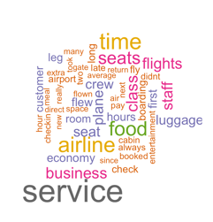
Text analyst
Items are often mentioned by our customers
Service
Seats
Time
Food
Luggage

Slide 24
Key Actionable Insights
Improving quality of service for passengers with airline status blue and price sensitivity 1 with promotional offers / discounts
Old people with flight delays tend to give bad ratings. Increasing comfort level for them by establishing infrastructure
Improving inflight service quality to personal travelers
Shopping discounts for female customers traveling with top 3 airline partners might increase the ratings
From sentiment analysis it is evident that customers are concerned about time, food and luggage. Providing more food options inflight and free check-in luggage will increase number of promoters

